Slide 1
Quantum computing

Slide 2
Introduction to Computing (~ Classical)
Is currently done on your laptop today
Numbers as we commonly use them are in decimal (base 10) format. Computers represent them in binary (base 2).
Each computational operation is done one step at a time.
Decimal vs. Binary
Decimal Representation
10³ | 10² | 10¹ | 10⁰
1000 | 100 | 10 | 1
The number 14: 1 in the 10’s and 4 in the 1’s

Slide 3
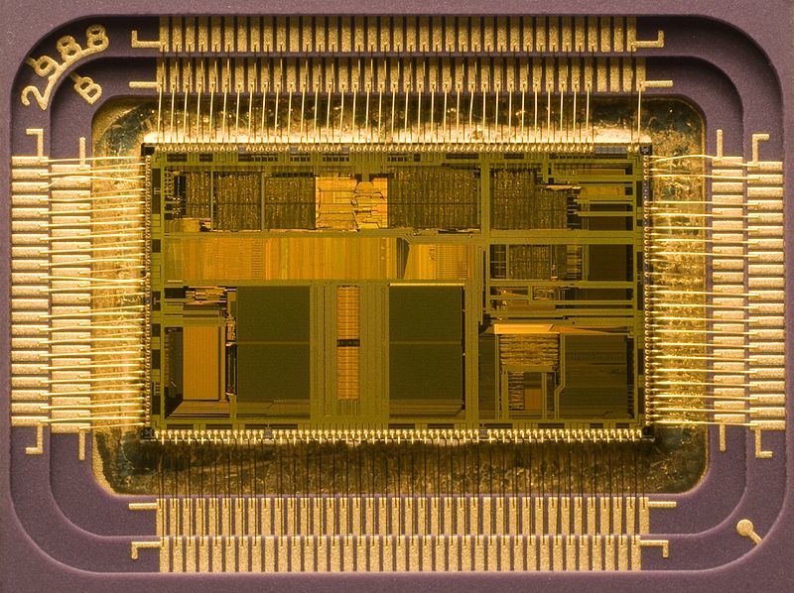
How do we do this?
How do we represent this in another base? Add up all the digits to get the same value.
Binary Representation
2³ | 2² | 2¹ | 2⁰
8 | 4 | 2 | 1
14 = 8+4+2 → 1110
BITS!
Shown is an Intel processor capable of performing 1,000,000,000 (1 billion) mathematical operations per second!
It is composed of ~500,000,000 individual Transistors! (Transisitors have no moving parts and are turned on and off by electrical signals)
The typical size of a transistor in the picture is about 0.04mm

Slide 4
What is a computation? (Let’s revise)
Generation of an output number (string of bits) based on an
input number.
…101101001…
“Black Box” or
Computer
Output
Input
…000111010…
How does the computer achieve this?

Slide 5
Digital electronics
Physical bit - electrical voltage
+5V = 1
0V = 0
Single bit operation
0
1
1
0
NOT gate

Slide 6
Two bit operations
0
0
1
1
0
1
0
1
0
0
0
1
AND gate
0
0
1
1
0
1
0
1
0
1
1
1
OR gate

Slide 7
Two bit operations
0
0
1
1
0
1
0
1
1
1
1
0
NAND gate
Not all the gates are needed
A small set of gates (e.g. NAND, NOT) is universal in that any logical operation can be made from them.

Slide 8
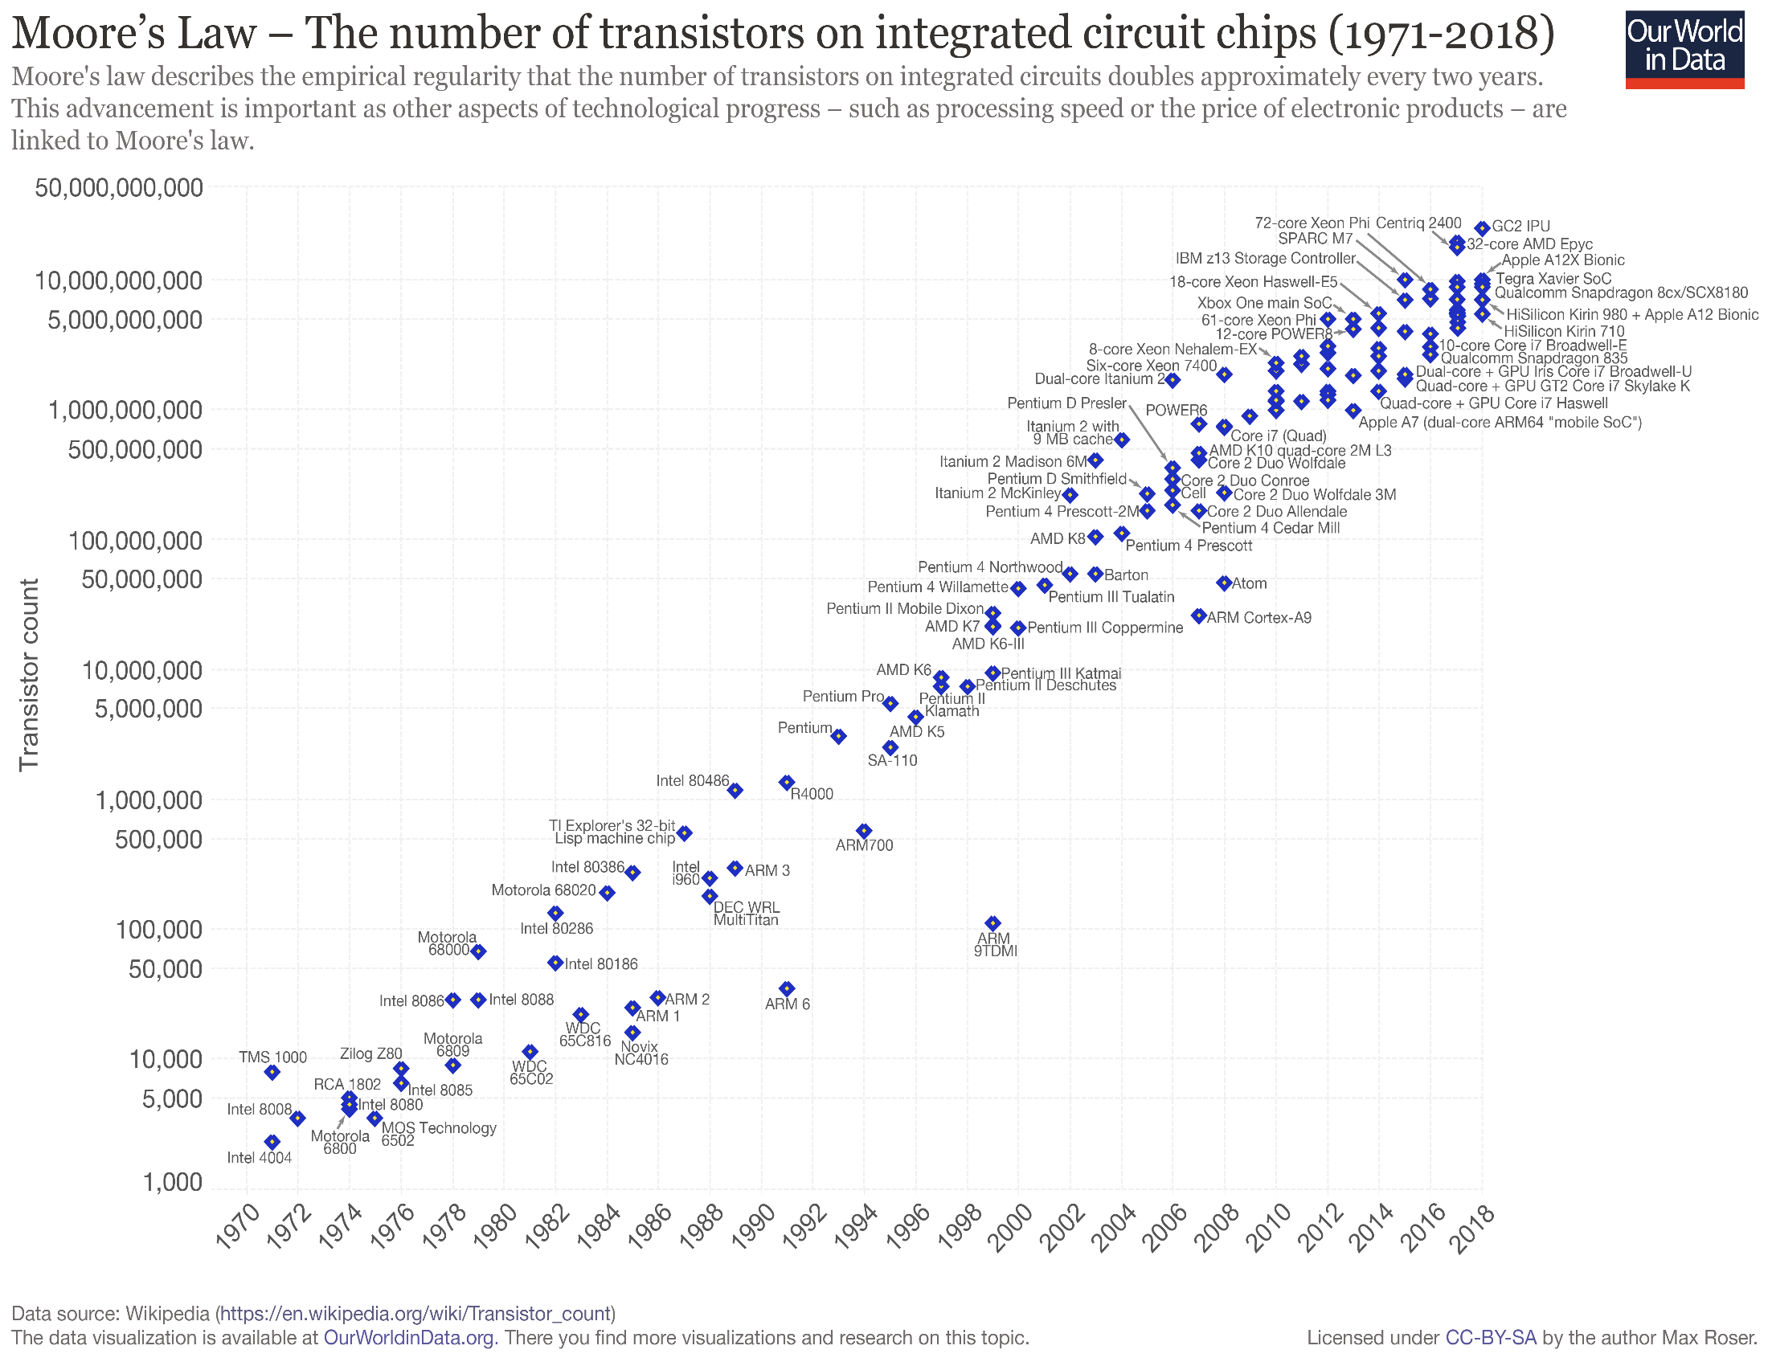
What Is Moore's Law?
Moore's Law refers to Moore's perception that the number of transistors on a microchip doubles every two years, though the cost of computers is halved. Moore's Law states that we can expect the speed and capability of our computers to increase every couple of years, and we will pay less for them. Another tenet of Moore's Law asserts that this growth is exponential.
Understanding Moore's Law
In 1965, Gordon E. Moore—co-founder of Intel (NASDAQ: INTC)—postulated that the number of transistors that can be packed into a given unit of space will double about every two years. Today, however, the doubling of installed transistors on silicon chips occurs closer to every 18 months instead of every two years.

Slide 9
Creating the Impossible?
Perhaps the idea of Moore's Law approaching its natural death is most painfully present at the chip manufacturers themselves; as these companies are saddled with the task of building ever-more-powerful chips against the reality of physical odds. Even Intel is competing with itself and its industry to create what ultimately may not be possible.
In 2012, with its 22-nanometer (nm) processor, Intel was able to boast having the world's smallest and most advanced transistors in a mass-produced product. In 2014, Intel launched an even smaller, more powerful 14nm chip; and today, the company is struggling to bring its 10nm chip to market.

Slide 10
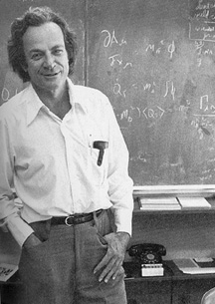
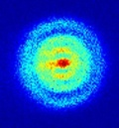
“Simulating Physics with Computers”
Richard Feynman – Keynote Talk, 1st Conference on Physics and Computation, MIT, 1981
“There is plenty of room at the bottom”
Nanotechnology in computer: Nano-computing
Computers in the 20th century showed a miniaturization of microprocessors and are in a process of being nano-metre scale.
1 nm= 2 times the size of hydrogen atom
5nm= 50times the dimension of one hydrogen atom
Quantum effects!!

Slide 11
Introduction
What is a quantum computer?
A quantum computer is a machine that performs calculations based on the laws of quantum mechanics, which is the behavior of particles at the sub-atomic level.
1982 - Feynman proposed the idea of creating machines based on the laws of quantum mechanics instead of the laws of classical physics.
1985 - David Deutsch developed the quantum turing machine, showing that quantum circuits are universal.
1994 - Peter Shor came up with a quantum algorithm to factor very large numbers in polynomial time.
1997 - Lov Grover develops a quantum search algorithm with O(√N) complexity

Slide 12
Classical Physics
Predictable outcomes!
Variables are continuous
Take on finite known values
Always has a known state
Binary numbers in the form of switches that are on or off!
Quantum Physics
Violate classical laws at a small scale (~h, Plank’s Constant)
Variables are discrete |0> or |1>
Can be in a superposition of values (representing all states simultaneously)
State is indeterminate until measured.

Slide 13
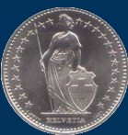
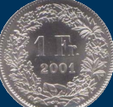
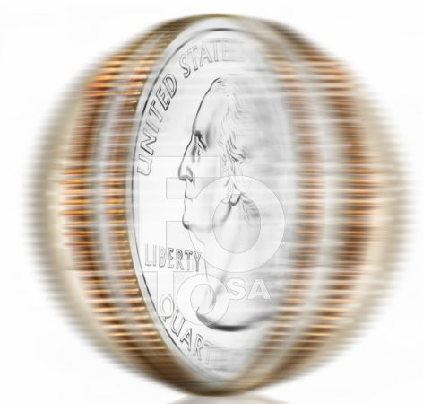
conventional memory:
Tossed coin
quantum memory:
Spinning coin
Result is either 0
or
1
Result is 0
and
1
(both)
sequence of 11 bits:
sequence of 11 quantum bits:
11111011011
(0+1)(0+1)(0+1)(0+1)(0+1)(1+0)
(0+1)(0+1)(1+0)(0+1)(0+1)
stores only one number:
2011
stores all numbers from 1 to
2048 (All possibilities !!)

Slide 14
Classical bits (Cbits)
The two states of a Classical bit by a pair of orthonormal vectors denoted by the symbols|0> and |1>.
It is convenient to represent the four states of two Cbits
|0>|0>, |0>|1>, |1>|0> and |1>|1> or more readably |00> |01> |10> |11>
Most compactly of all, using the decimal representation of 2bit number represented by the pair of C-bits
|0>₂, |1>₂, |2>₂, |3>₂
One represents the states of ‘n’ as the 2^{n} orthonormal vectors in 2^{n} dimensions.
Thus for example |19>₆ = |010011>= |0>|1>|0>|0> |1> |1>

Slide 15
Quantum bits
A major part of quantum mechanics consists of an analogous expansion of the notion of the state of a Cbit, called in this extended setting a quantum bit or Q bit.
In general state of a single Qubit is a superposition of the two classical basis states
Where the amplitudes α and β are complex numbers constrained
only by the normalization condition
The general state of n Qubits has the form

Slide 16
With complex amplitudes constrained only by the normalization condition
Most general possible state of two Qubit has the form

Slide 17
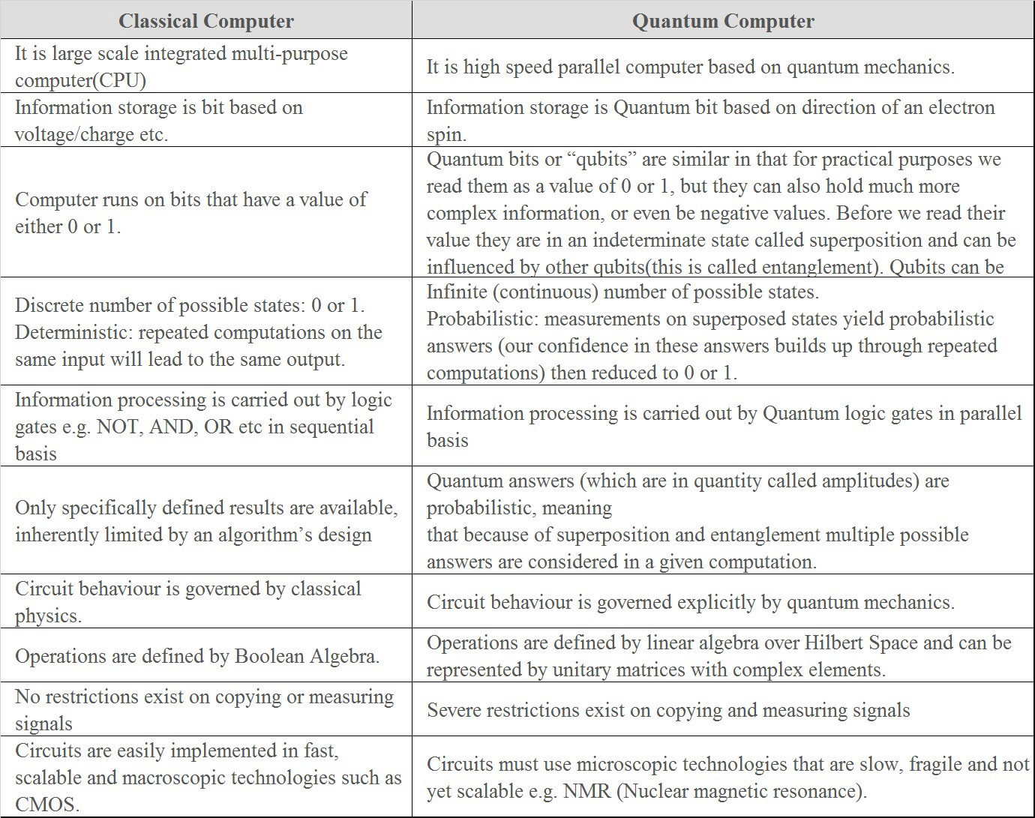

Slide 18
Implementations of a “Qubit”
Polarization of a photon.
Spin orientation of an electron
Energy level of an atom
NMR, Ion traps,…

Slide 19
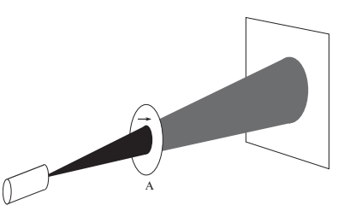
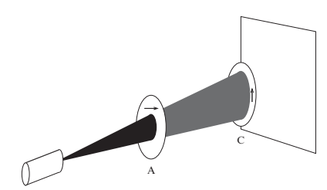
Photon polarization experiment (using-unpolarized light)
case1
screen
Horizontal polarizer ‘A’
Single polaroid attenuates
unpolarized by 50 percent
source of un-polarized light
case2
Two orthogonal polaroid
block all photons

Slide 20
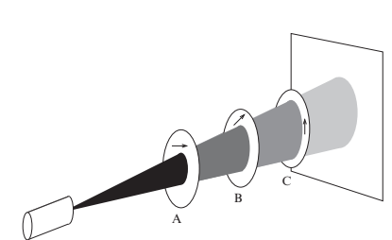
case3
Inserting a third polaroid
allows some photons to pass
How do we understand these results?
Malu’s law !
What about, if source is very dim !! (with very few photons!!)
Rules of Quantum Physics!!!
Quantum Mechanics
Represent the light polarization by a unit vector: a vector of length ‘1’,
pointing appropriate direction.
Example: horizontally polarized light
vertically polarized light
symbol:
|0⟩
symbol:
|1⟩
H
V

Slide 21
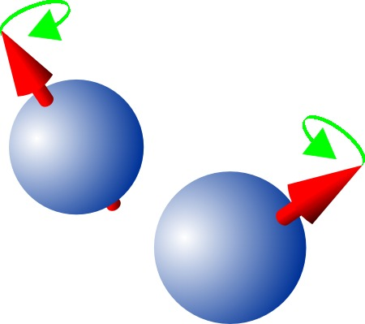
Qubits from Electron spin

Slide 22
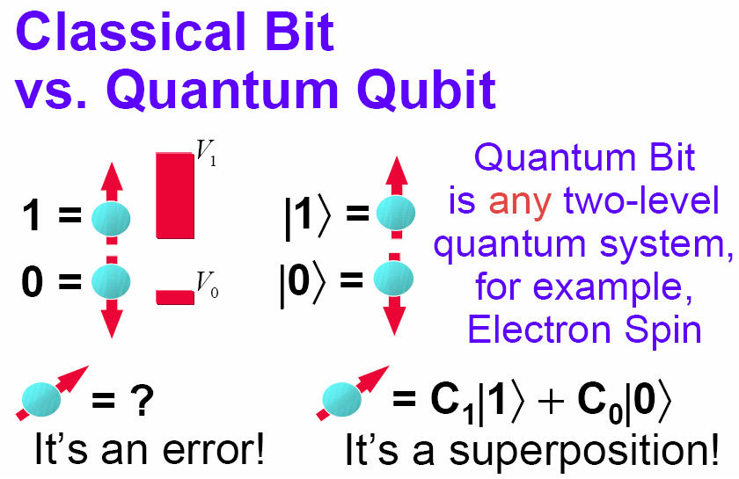
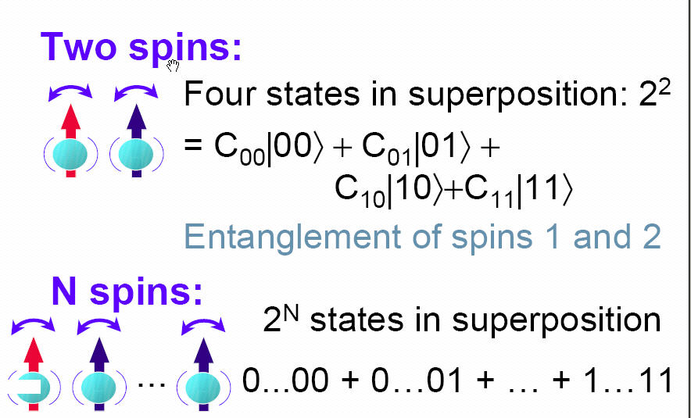
Qubits from electron spin
Classical Bits
Quantum bits: Superposition state
spin up
spin down
It’s a superposition!
It’s an error!

Slide 23
When you measure the spin, it can be in spin up or spin down state. But before you measure It, it can be in a quantum super position state; where these coefficients C₁&C₂ indicate the relative probability of finding the electron in one state or other.

